Slide 1
Mobile Direct Marketing
Ted McNulty
Director of Performance Advertising

Slide 2
High Quality, Massive Network
Reaches 86% of US smartphones
218M
60B
77K+
Unique Users
Requests
Top 4 Largest Networks
Sites & Apps
4 RTB Partners Integrated
1st or 2nd
Ad Call

Slide 3

Higher Ad Call, Higher Value
Most sites are integrated with multiple networks, but request ads in sequential order
Jumptap tends to get ad call #1 (or #2) because of our volume
We fill the most valuable traffic, leaving what we don’t want for everyone else
Ad calls further down the chain see diminishing returns

Slide 4

Experts in Direct Response
Lead Generation
Click-to-call
Mobile Commerce

Slide 5
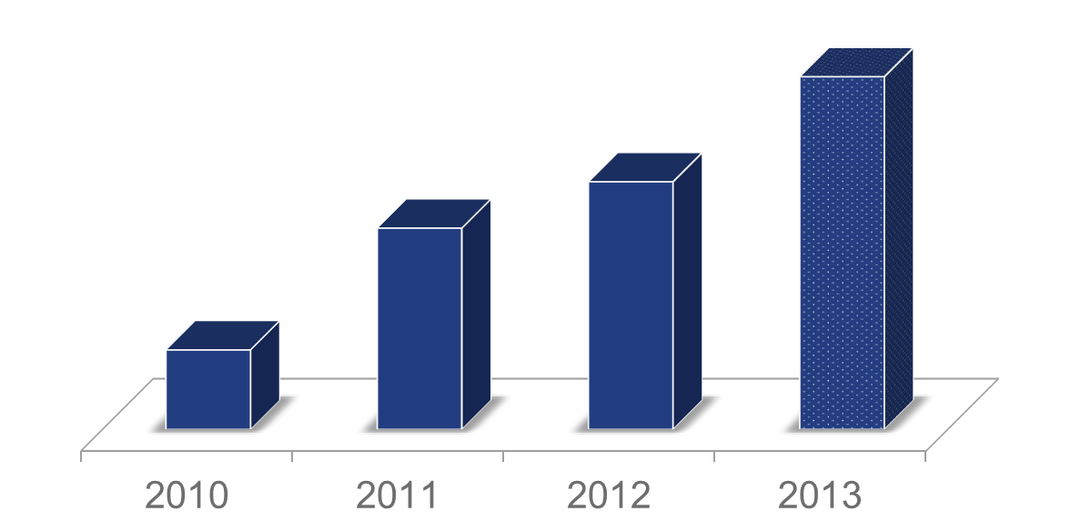
Strength Fueling Growth
Annual Performance Revenue
*2013 Projected

Slide 6
















Trusted by Big Brands

Slide 7

Process Focused on ROI
Understand
Click to call
Short/Long Form
mCommerce
Consultation
Best practices
Banner Strategy & Page Flow
Execution
Conversion tracking
Site performance analysis
Optimization
Eliminate underperforming
sites
Raise bids
on top sites
$

Slide 8
Crawl, Walk, Run
Spend with confidence:
Daily budget cap
Small launch budget
Scale built from finding
successful base
Admin access
No spend obligation
“I can’t just blow
through budget.”
“My budget will be lost.”
“Mobile is new
and unproven.”
“I might not meet my CPA.”

Slide 9
Target

Slide 10
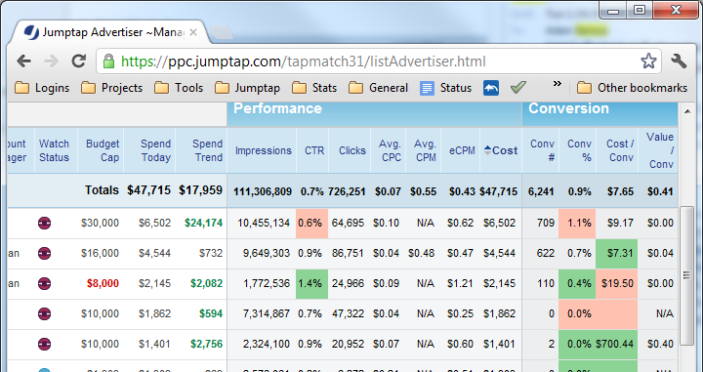


Industry Leading Targeting Technology
Geographic
OS
Handset
Demographic
Carrier
Contextual
Time of Day
Frequency Capping
Retargeting
"Jumptap's [technology] allows us to precisely target our campaigns and their account management has been very responsive in helping us out.“
Jason Cianchette

Slide 11
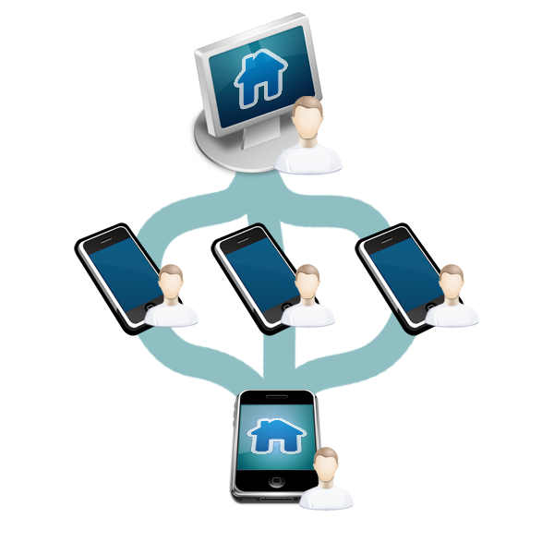
Drive Conversions with Retargeting
Create pools of users based on events like installs or conversions, then customize messaging:
Positive or negative
Draw insights
Targeted creative
Tailored messages
PC-to-Mobile
Follow up with interested users with mobile campaigns that reach specifically visitors to your online site or store.

Slide 12
















Breakthrough Audience Targeting
Combine online and offline mobile behavior for a real-world view of the consumer
Home
High Household Income. Married with 2 kids. In market for a hybrid car
Online
Behavior
Work
Business executive. Browses Forbes Finance. Delta Frequent Flyer. Booking trip to LA on Expedia
Real World
Behavior
Play
Shops at LL Bean Eats at PF Changs. Prefers Ann Taylor over Banana Republic
Mobile
Behavior

Slide 13
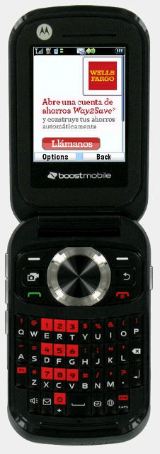
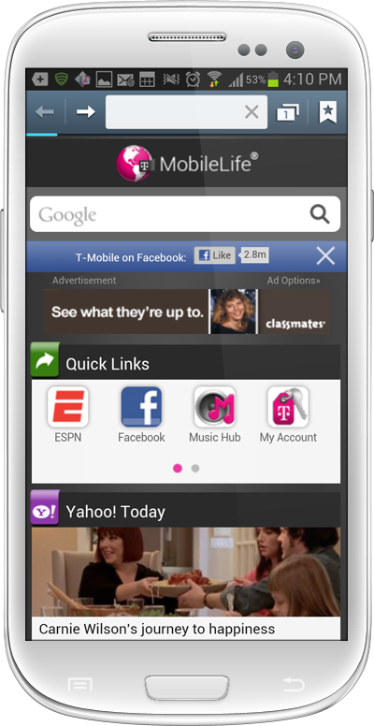


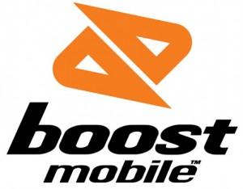



Targeting By Carrier
On-deck exclusives
Carrier portals are “on-ramps” to the mobile internet and advertisers can reach consumers on the first few clicks to the internet.
Carrier inventory currently receives some of the highest click through rates on mobile.
Standard banner ads on carrier portals average 1%-3%+ CTR .

Slide 14
Execute

Slide 15

Campaign Setup
Test all ad sizes
Bidding strategies
Test multiple creative executions: Background color, text ads, animation, messaging
Break-out campaigns by platform: iOS, Android
Track conversions to optimize campaign

Slide 16

Efficient Pricing
We recommend CPC; support CPA, but usually transition to CPC
CPC Benefits:
Access to higher quality traffic
Extend campaign reach and scale
Beating CPA results in increased margins
Avoids “scale plateau”
CPA Caveats:
Different management
Hard to scale
8 ^{OF} 10
Campaigns meet or beat CPA goal

Slide 17

Conversion Tracking to Improve ROI
Landing Pages
Pixel dropped on any conversion page
Useful for forms and storefronts
Parameter Pass
Passes non-P.I.I. conversion info to advertiser
Includes: site, handset, carrier, etc.
Call Center Events
Call Duration
Pocket-dial prevention
Server-side
API call that utilizes clickID
Transmits a call between client and internal servers to attribute a conversion.
Secondary Events
Track events the come after the primary conversion
Useful for partial forms, eCommerce, etc

Slide 18












High Quality Sites & Apps

Slide 19


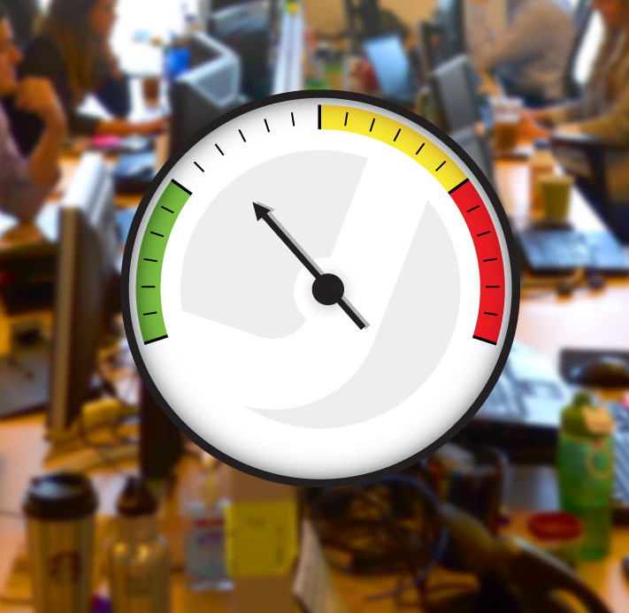


Rapid Optimization by Our Experts
To maximize performance, Jumptap tweaks the targeting mix, including:
Publishers
Sites
Platform
Handset
Bid
Location
Carrier/Wifi
Creative
Frequency

Slide 20
Analyze Results And Start Again

Slide 21
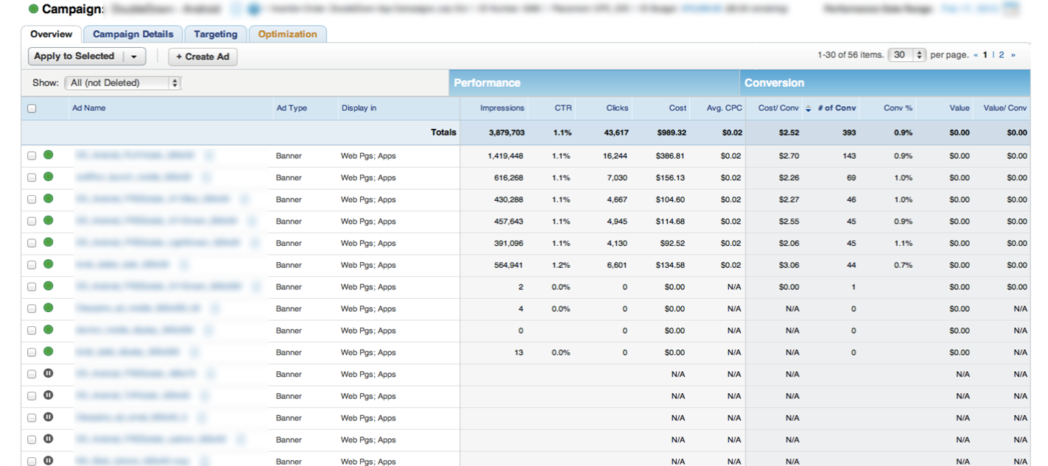
Tracking Results In Mobile

Slide 22
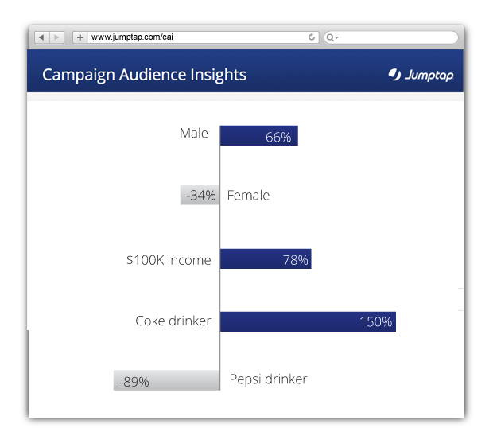
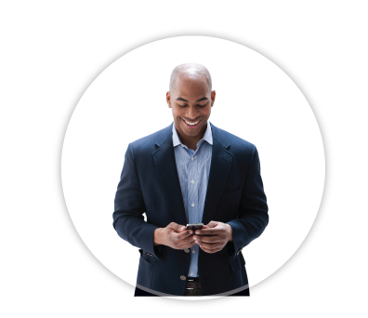
Understand Who Saw Your Ads and Who Engaged with Them

Slide 23
Full Account Management & Support
Pre-Campaign
Best practices
Banner analysis
Mid-Campaign
24/7 optimization
Weekly calls
Expert team
Post-Campaign
Wrap-up reports
Audience Insight reports
Recommendations

Slide 24
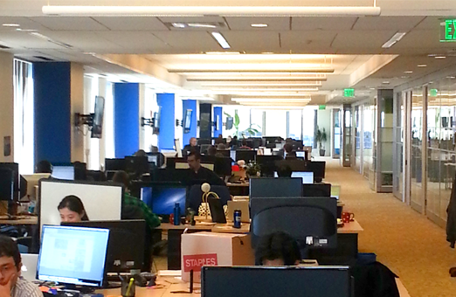
…and a Team of Data Scientists
201 Employees
Data Analysts
Optimizers
Engineers
Researchers

Slide 25
Response Type:
Click-To-Call

Slide 26
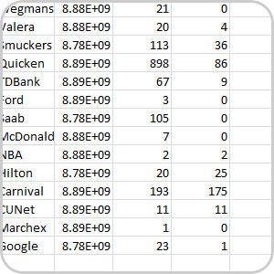
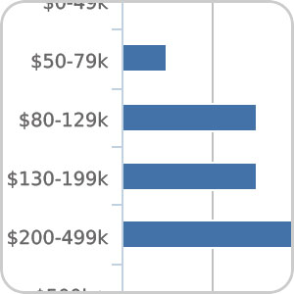
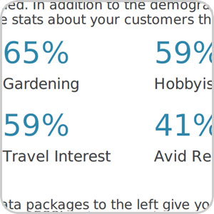
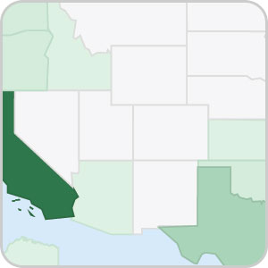
Click-To-Call Campaigns
Unique technology to measure call duration, and optimize campaign:
Site
Handset
Banner
Category
Sophisticated optimization approach lowers acquisition costs and increases quality.
Audience analytics provides a detailed demographic report of who called and who converted.
Call Log
Caller Financials
Caller Interests
Caller Location

Slide 27



CASE STUDY
Direct Response Agency - Insurance Industry
CAMPAIGN
RESULTS
Goal: Generate leads
in the form of quotes
Method: Click to Call
CPA Goal: $20.00
221%
ROI (Approx.)
$7.77
CPA Average
6,000
Quotes, Q1
CTR
Became Goal
CLIENTS INCLUDE:

Slide 28



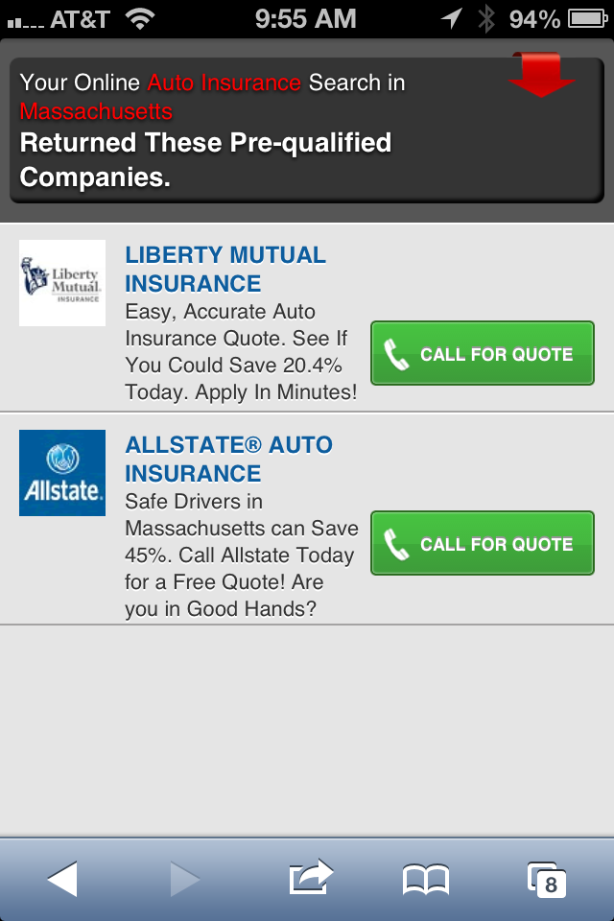




CASE STUDY
Direct Response Agency - Insurance Industry
Original Banners
Modified Banners
Landing
Page
Launch
Page

Slide 29
Response Type:
Lead Generation

Slide 30
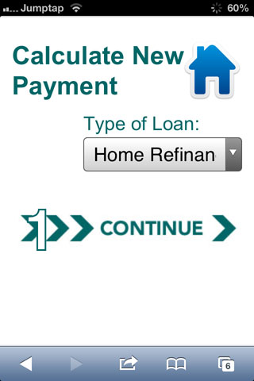
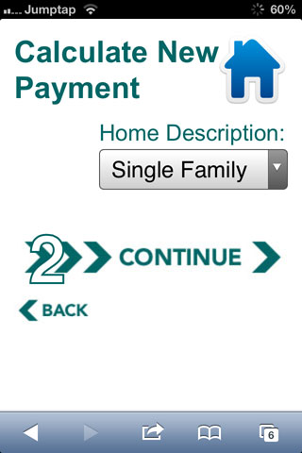
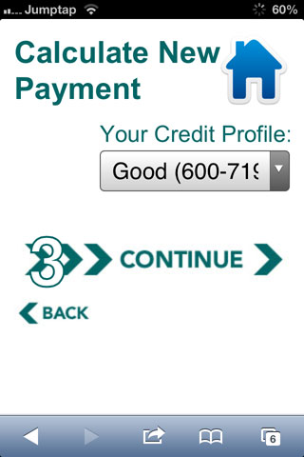
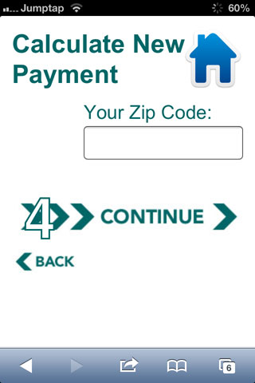
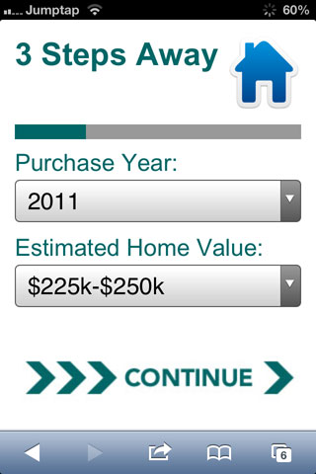
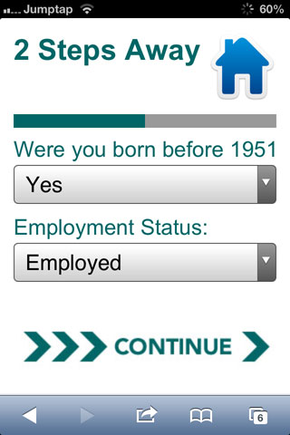
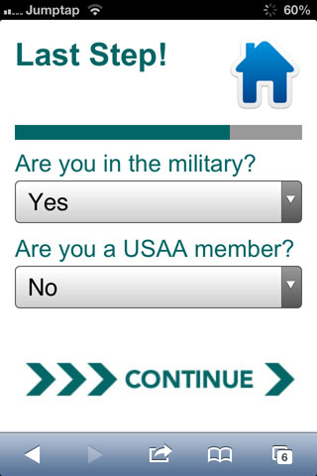
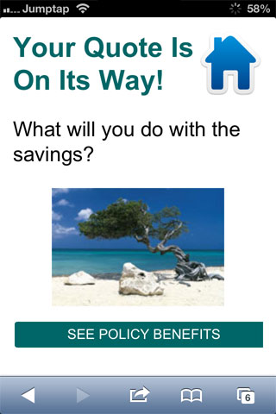
Mobile Lead Generation
Long-form lead generation is possible on mobile
Simple navigation
Pre-populated fields
Drop down menus

Slide 31
Response Type:
M-Commerce

Slide 32


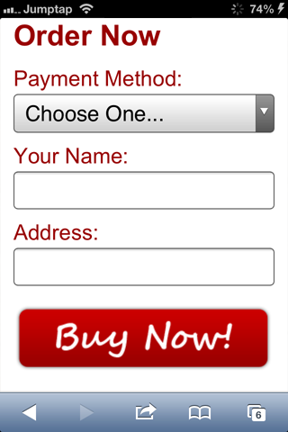
M-Commerce Best Practices
Landing Page
Product Page
Order Form
Notes:
Large, easy to read text and call to action buttons
Limited number of options to choose from
Short, simple benefit statements
Large graphics
Large compelling graphics
Limited Choices
Strong benefit statement
Simple navigation
Drop down menus

Slide 33
Summary
Jumptap is a clear leader in Mobile Performance Advertising:
Industry leading targeting.
Advanced conversion tracking technology.
Sophisticated optimization process.
Large, quality audience across all platforms.
Unmatched knowledge of how to run successful Mobile Performance programs gained from thousands of campaigns.
Trusted Mobile Performance partner for top brands and agencies.

Slide 34
Thank You.

